Slide 1
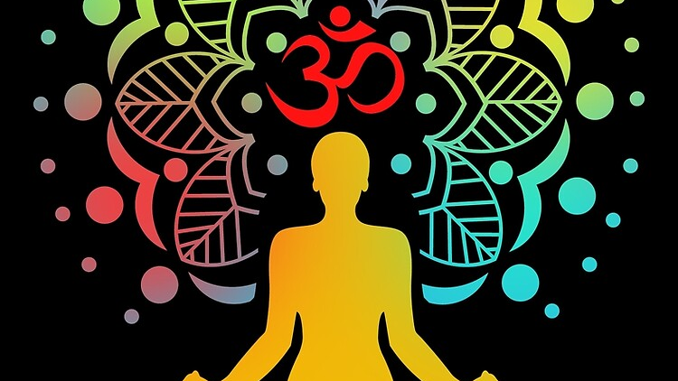
YogiFi

Slide 2

What is YogiFi ?
YogiFi is a revolutionary app that seamlessly blends the wisdom of ancient Indian yoga with cutting-edge technology.
With YogiFi, users embark on a journey of self-discovery and improvement.
It not only provide the users with guided yogic postures but in addition it also recognizes your posture during a particular posture and predicts its accuracy.

Slide 3
Sprint Work 2
During this sprint, our focus was on crafting the frontend user interface (UI) of our website using the powerful React JS library.
Our primary goal was to establish the foundational structure and layout of the website
Additionally, this sprint provided us with the opportunity to explore MoveNet, a model for human pose estimation.
Through our research and experimentation with MoveNet, we gained valuable insights into its capabilities and potential applications.

Slide 4
Sprint Work 3 (Spring Break)
During the sprint, our focus was to train the model by creating 3D images of 7 yogic poses, including Chair, Cobra, Dog, Shoulder stand, Triangle, Tree, and Warrior.
We collected multiple 3D photos for each yogic posture, which we transformed into various angles using Photoshop for testing.
Additionally, we successfully implemented a TensorFlow model and are currently training it to increase its accuracy.
Through our research and experimentation, we gained valuable insights into the complexities of pose estimation and the challenges involved in accurately and capturing human movements.

Slide 5
Sprint Work 4
Our focus during the sprint was on developing our React Native app. We chose Expo Go for easy testing on Android and iOS via QR code scanning, bypassing React Native CLI.
Expo Go provides valuable features like built-in libraries, over-the-air updates, and a simplified workflow, which complement our project goals of efficiency and accessibility.
Additionally, we found ways to add our tensor flow model in mobile app like TensorFlow.js with React Native's JSI (JavaScript Interface), TensorFlow Lite or using a WebView Component
We improved model's efficiency by expanding the image dataset and conducting additional training sessions.

Slide 6
Next Sprint
In the coming Sprint we will try to complete the app.
Our main goal of this sprint will be increasing the accuracy of the model and implement the AI model in app.
In this sprint, we'll update the Git repository with project details and additional documentation.

Slide 7
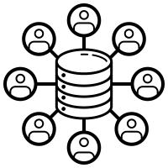
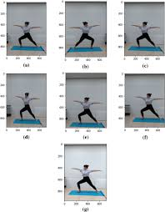
Data - Collection
We collected 3D images and videos of various yoga poses to train our AI models.
These data were essential for training and testing the accuracy of our pose estimation algorithms.
Data ?
The poses included Chair, Cobra, Dog, Shoulder Stand, Triangle, Tree, and Warrior.
Multiple 3D photos were captured for each pose, and Photoshop was used to transform them into various angles.
The diverse dataset enabled accurate recognition of various pose perspectives.

Slide 8

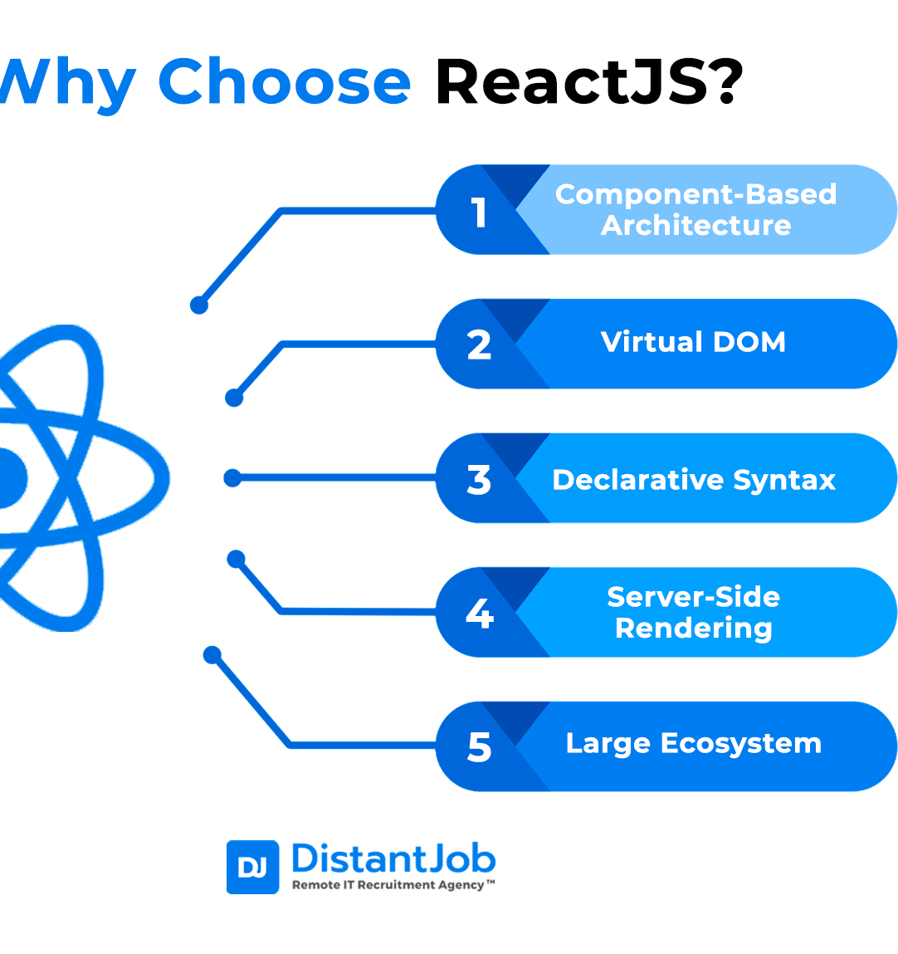
Technologies Used - ReactJS
Its a JavaScript library for building user interfaces
Why ReactJS?
It uses a component-based architecture, which promotes code reusability and modularity.
Component-based architecture simplifies software development by breaking down applications into manageable units.
ReactJS employs a virtual DOM (Document Object Model) , which optimizes performance by minimizing unnecessary re-renders.
It uses a declarative syntax that allows approach of describing the desired outcome or result of a piece of code.

Slide 9
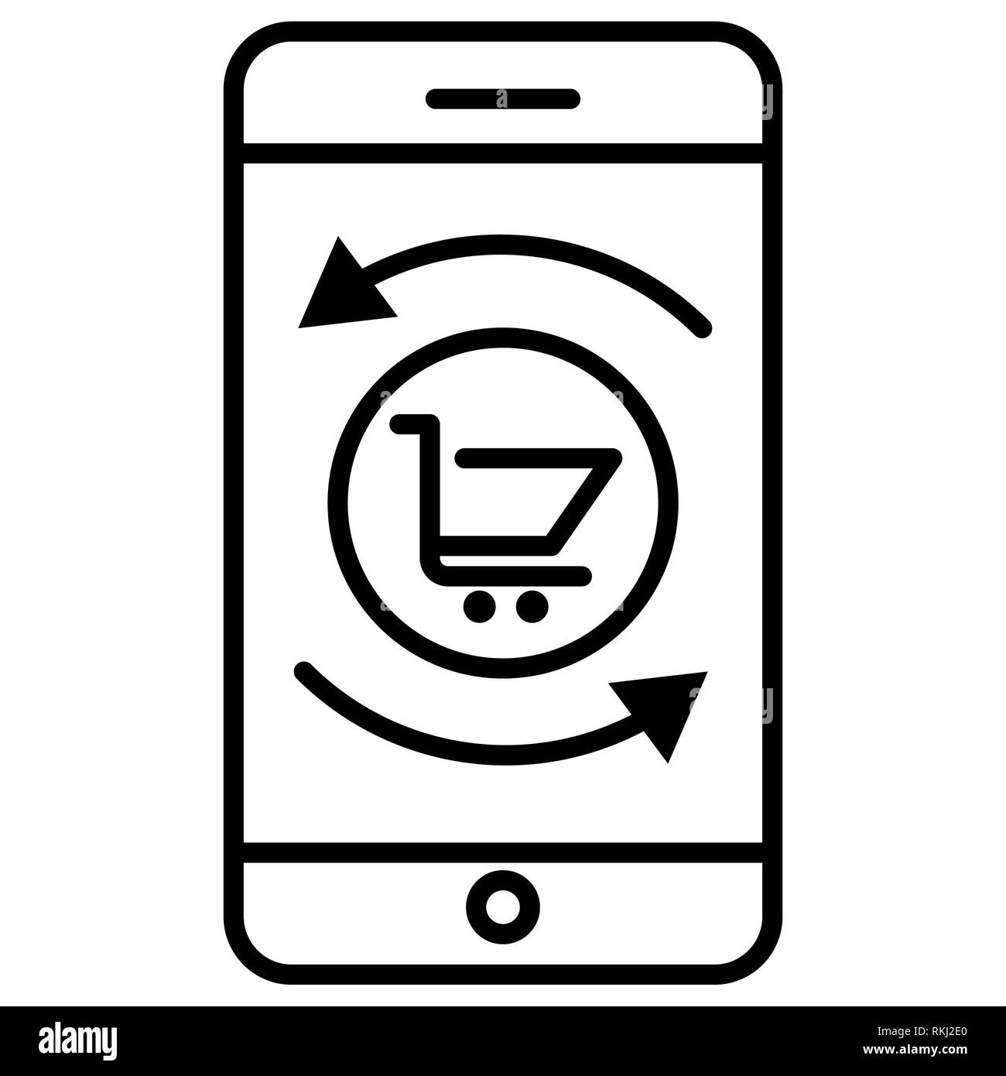
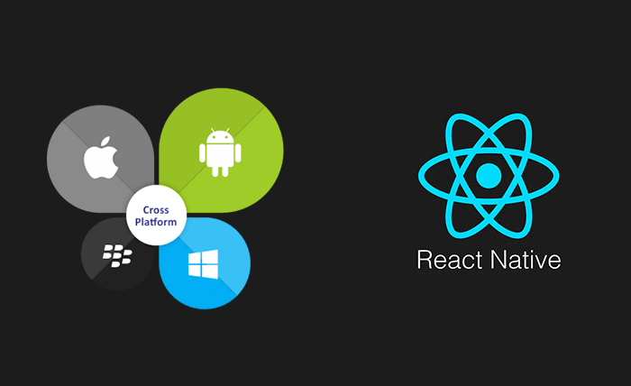
Technologies Used - ReactNative
It is a framework for building mobile applications using JavaScript and React.
Why ReactNative?
It allows for cross-platform development, enabling us to build apps for both Android and iOS simultaneously.
React Native seamlessly maps built-in components to native counterparts, ensuring a smooth user experience.
It enables code and component reuse across platforms, leveraging React's power.
With direct access to native APIs, React Native delivers superior performance over traditional hybrid approaches.

Slide 10
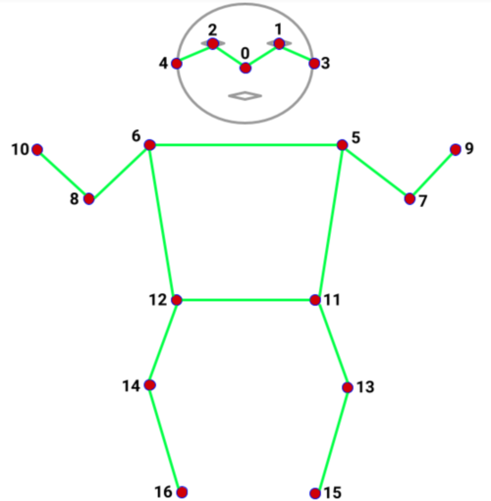
AI Model- TensorFlow MoveNET
MoveNet is a machine learning model for real-time human pose estimation developed by Google.
MoveNet ?
MoveNet is an ultra fast and accurate model that detects 17 keypoints of a body.
MoveNet is lightweight and efficient, making it suitable for mobile and web applications.
The model is offered on TF Hub with two variants, known as Lightning and Thunder.
Lightning is intended for latency-critical applications, while Thunder is intended for applications that require high accuracy.

Slide 11

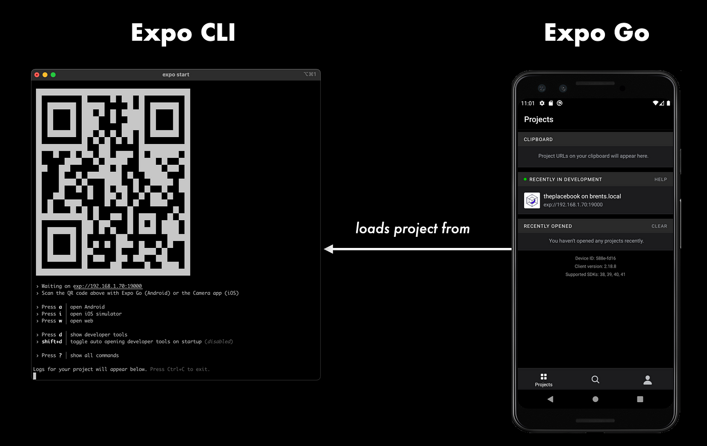
Testing with - ExpoGo
Expo Go is a platform for testing and deploying React Native apps on real devices.
It simplifies the development workflow by providing features like QR code scanning for instant testing.
ExpoGo ?
It allows easy testing on both Android and iOS devices without the need for complex native setup or configuration.
It provides access to a wide range of built-in libraries and APIs, reducing the need for third-party dependencies.
Supports over-the-air updates, allowing for seamless app updates and bug fixes.

Slide 12
Learnings - Challenges
Seamless Integration: YogiFi seamlessly blends the wisdom of yoga with modern technology, providing users with guided postures and real-time feedback.
Cross-Platform Compatibility: The use of ReactJS for the website and React Native for the mobile app ensures a consistent user experience across different platforms.
AI Model Implementation: Integration of MoveNet for pose estimation enables accurate recognition of yoga postures, enhancing user feedback and guidance.
Performance Optimization: Leveraging React's virtual DOM and React Native's direct access to native APIs, YogiFi delivers superior performance and responsiveness.
Data-driven Approach: Continuous expansion of the dataset and retraining of the AI model have significantly improved its accuracy and performance over time.

Slide 13
Future - Goals
Enhanced User Experience
Advanced Analytics
Security
Community Engagement: Building a community around YogiFi to foster collaboration, support, and sharing of knowledge and experiences among users.
Accessibility: Ensuring that YogiFi is accessible to all users, including those with disabilities, by implementing accessibility features and optimizations.
Integration with Wearable Devices: Exploring integration with wearable devices to provide real-time feedback and monitoring during yoga sessions.

